Slide 1
Unit 1
Chapter 1
Lesson 1
Exploring Pennsylvania
Text pages 10-17

Slide 2
Visual Literacy
Look at the picture on pages 2-3 in your social studies book. Then read the quote on the top of page 3, and write at least two lines about what you think the author means.

Slide 3
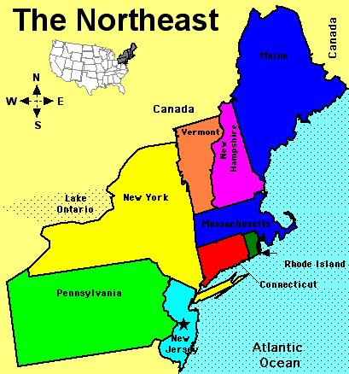
Pennsylvania is located in the northeastern part of the U.S.

Slide 4
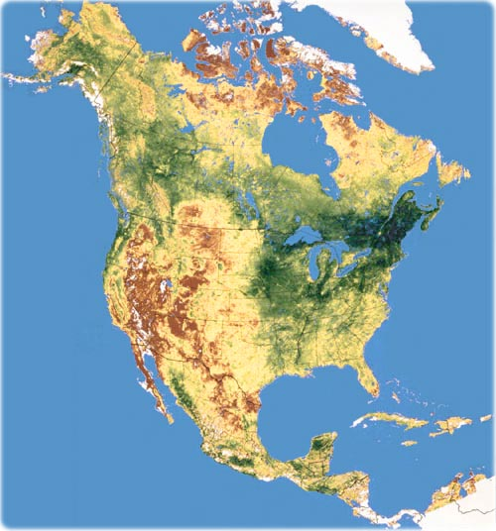
The United States is on the North American continent.

Slide 5
Pennsylvania is bordered by six states: New York, New Jersey, Delaware, Maryland, West Virginia, and Ohio.

Slide 6
Pennsylvania is nicknamed the Keystone State.

Slide 7
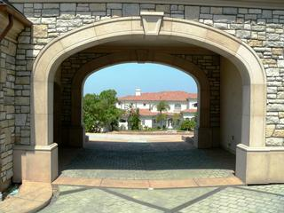
A keystone is the stone at the top of an arch that supports the other stones.

Slide 8
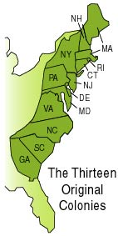
In the original 13 colonies, Pennsylvania was in the middle like a keystone.

Slide 9
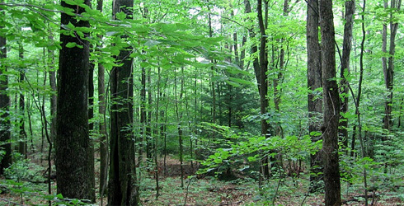
Over half of Pennsylvania is covered by forests.

Slide 10
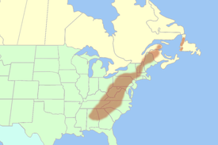
All of Pennsylvania’s mountains are part of the Appalachian Mountains.

Slide 11
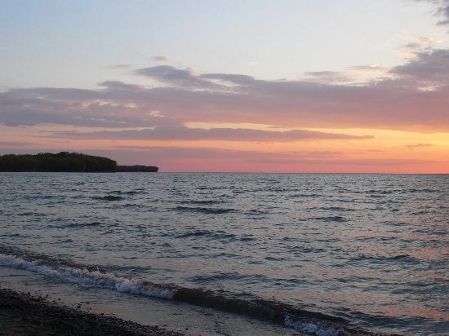
Lake Erie borders Pennsylvania’s northwest corner.

Slide 12
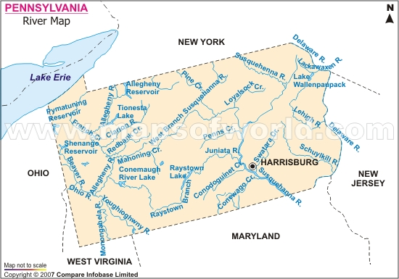
There are several important rivers in Pennsylvania: Delaware, Susquehanna, Monongahela, Allegheny, and Ohio.

Slide 13
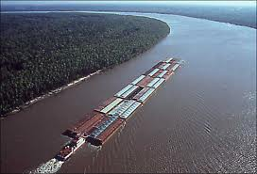
Huge amounts of freight can flow out of Pennsylvania by moving it by boat down the Ohio River which is a tributary of the Mississippi River.

Slide 14
Scrabble Summary
Using the word “KEYSTONE”, complete a scrabble summary describing what you learned today about Pennsylvania.
KEYSTONE

